Slide 1
Process for Making Sense of Data Lecture 2
Md. Golam Rabiul Alam
[Including slides from Prof. John Canny of UC, Berkeley]

Slide 2

Measurement of the strength of the relationship between two variables
Correlation Coefficients:
The Correlation Coefficients (r) quantifies the linear relationship between the variables by generating values from −1.0 to +1.0.
Positive numbers for r indicate a positive correlation between the pair of variables, and negative numbers indicate a negative correlation.
A value of r close to 0 indicates little or no relationship between the variables.
Here, x_{i} are the individual values of x,
y_{i} are the individual values of y,
is the mean of the x variable,
is the mean of the y variable,
s_{x} and s_{y} are the standard deviations of the variables x and y, respectively,
and n is the number of observations.

Slide 3
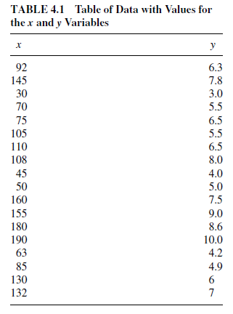
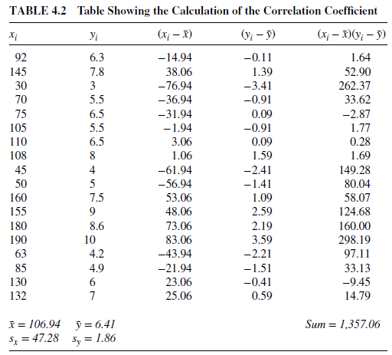
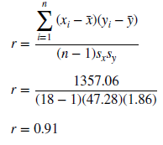
Correlation Coefficients

Slide 4
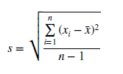
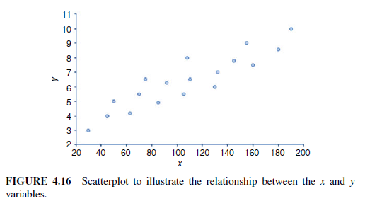
Correlation Coefficients
Standard deviation: The standard deviation is the square root of the variance.

Slide 5
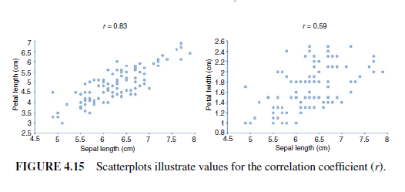
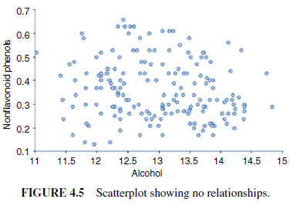
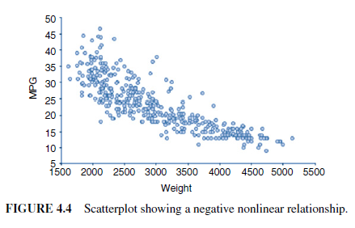
Correlation Coefficients

Slide 6
Correlation Coefficients

Slide 7
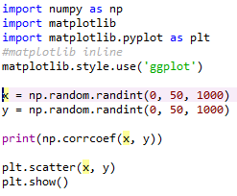
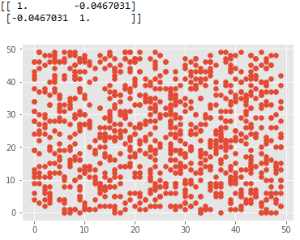
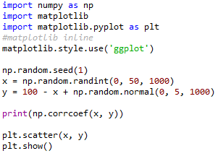
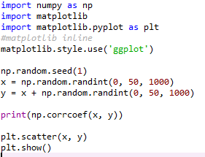
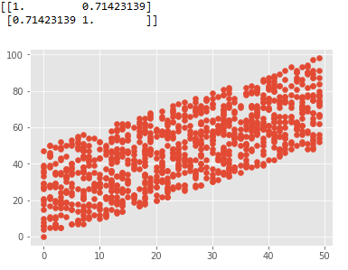
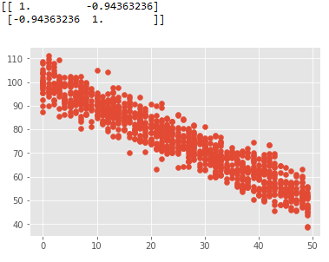
Correlation Coefficients using Python
plt.scatter(x, y) plt.show()

Slide 8
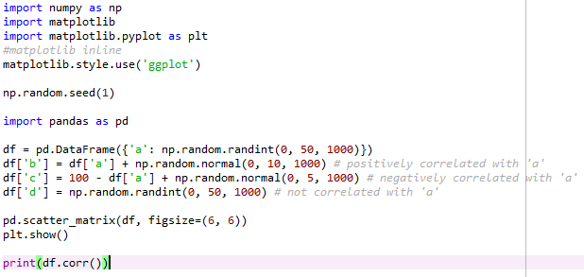
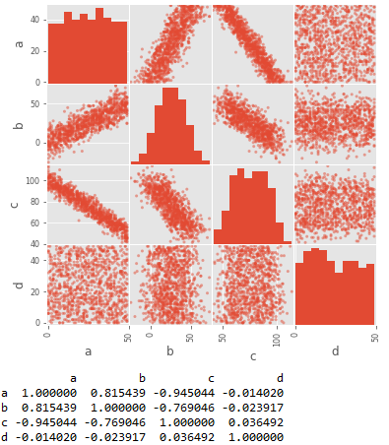
Correlation Coefficients using Python
plt.scatter(x, y) plt.show()

Slide 9
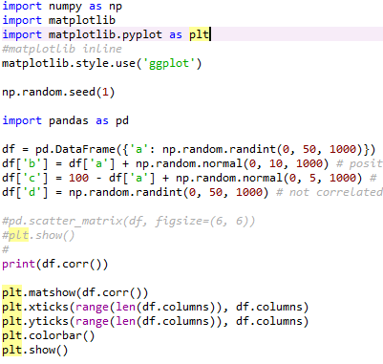
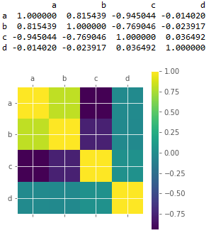
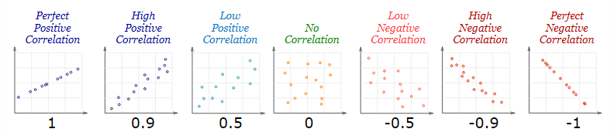
Correlation Coefficients using Python
plt.scatter(x, y) plt.show()

Slide 10
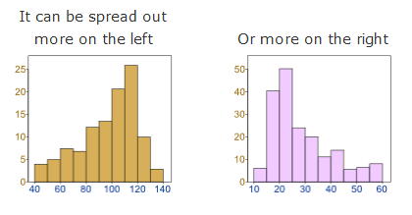
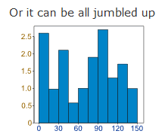
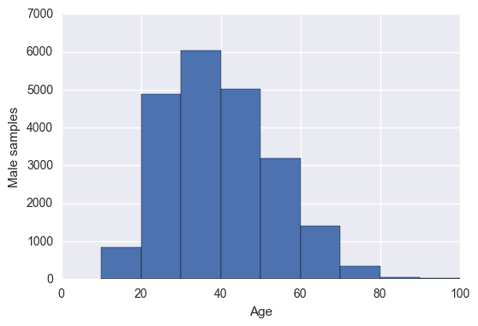
Data Distribution

Slide 11
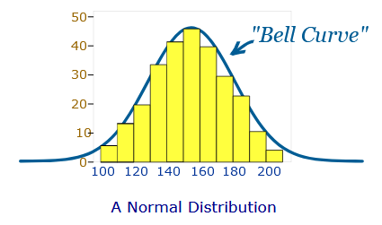
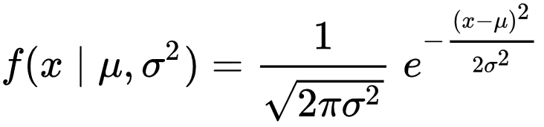
Normal Distribution
In probability theory, the normal (or Gaussian or Gauss or Laplace-Gauss) distribution is a very common continuous probability distribution
The probability density of the normal distribution is
The Normal Distribution has:
mean = median = mode
symmetry about the center
50% of values less than the mean and 50% greater than the mean

Slide 12
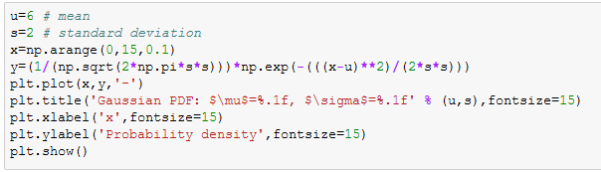
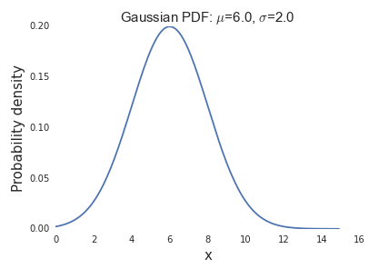
Python Code for Normal (Gaussian) Distribution

Slide 13
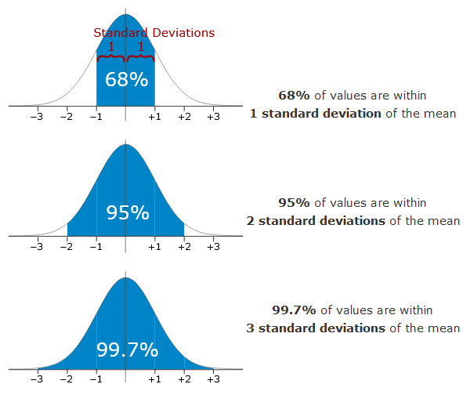
Properties of Normal Distribution

Slide 14
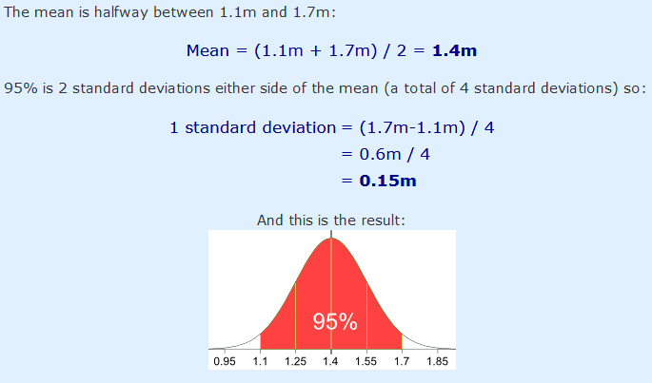
Example 1
95% of students at school are between 1.1m and 1.7m tall. Assuming this data is normally distributed can you calculate the mean and standard deviation?

Slide 15
Standard Score or “z-score”
The number of standard deviations from the mean is also called the "Standard Score", "sigma" or "z-score".
Example 2: In that same school one of your friends is 1.85m tall. Find out his z-score.

Slide 16
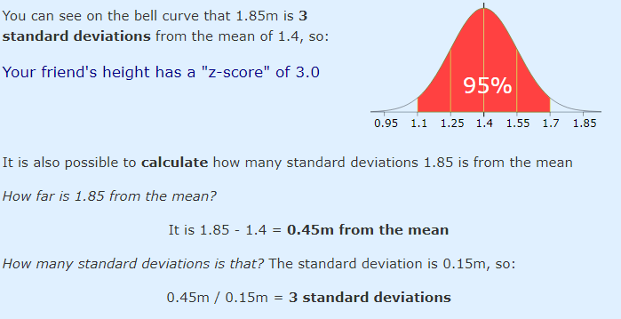
z-score
z-score (for one sample) = (x – μ) / σ = 1.85 – 1.4 / 0.15 = 3.0

Slide 17
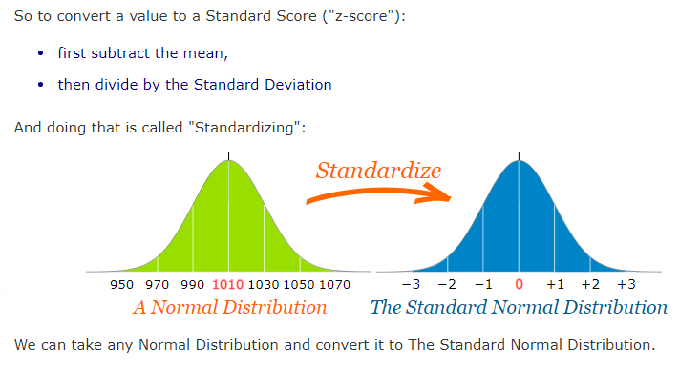
Standard Score or “z-score”

Slide 18
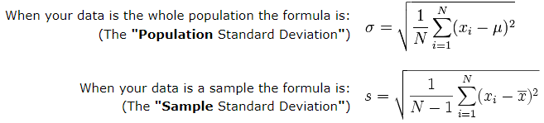
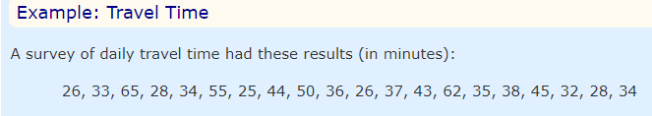
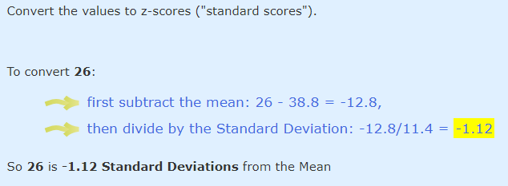
Standard Score or “z-score”
The Mean is 38.8 minutes, and the Standard Deviation is 11.4 minutes

Slide 19
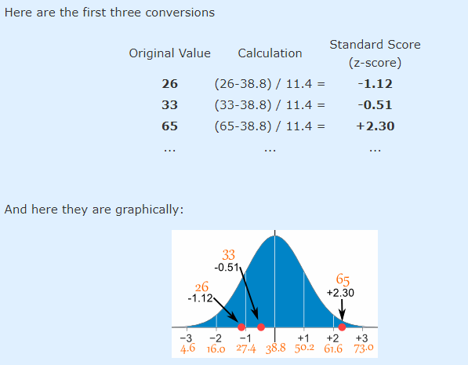
Standard Score or “z-score”

Slide 20
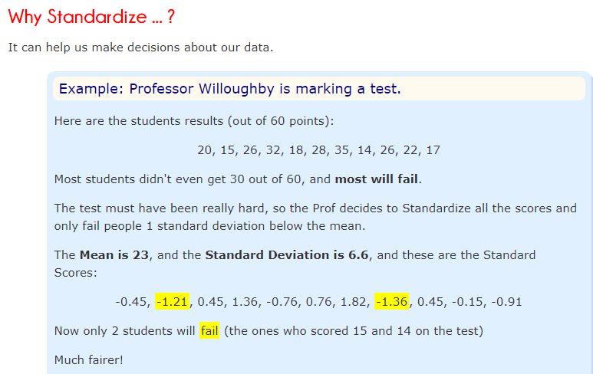
Standard Score or “z-score”

Slide 21
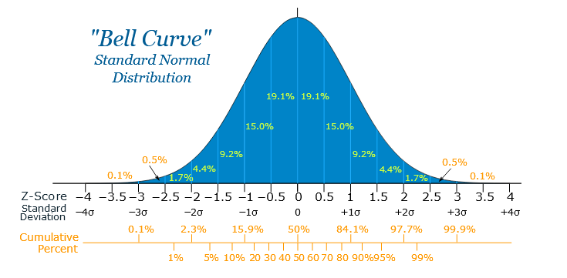
Another Example
Your score in a recent test was 0.5 standard deviations above the average, how many people scored lower than you did?

Slide 22
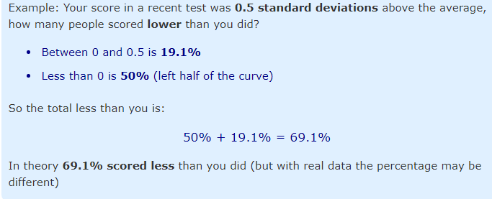
Example

Slide 23
Hypothesis Testing
A hypothesis is an educated guess about something in the world around you. It should be testable, either by experiment or observation. For example:
A new medicine you think might work.
A way of teaching you think might be better.
A possible location of new species.
A fairer way to administer standardized tests.
It can really be anything at all as long as you can put it to the test.

Slide 24
Hypothesis Statement
General format:
“If I…(do this to an independent variable)….then (this will happen to the dependent variable).”
If I (give patients counseling in addition to medication) then (their overall depression scale will decrease).
If I (give exams at noon instead of 7) then (student test scores will improve).
If I (look in this certain location) then (I am more likely to find new species).
If I (make the question hard) then (I am more likely to become famous!)

Slide 25
Why is it important?
Hypothesis testing in statistics is a way for you to test the results of a survey or experiment to see if you have meaningful results.
You’re basically testing whether your results are valid by figuring out the odds that your results have happened by chance.
If your results may have happened by chance, the experiment won’t be repeatable and so has little use.

Slide 26
First Step: Formulating Null Hypothesis
Null hypothesis is always the accepted fact.
DNA is shaped like a double helix.
Either support or reject null hypothesis.
Null hypothesis is nullfiable (something you can reject)

Slide 27
Finding Null Hypothesis
A researcher thinks that if knee surgery patients go to physical therapy twice a week (instead of 3 times), their recovery period will be longer. Average recovery times for knee surgery patients is 8.2 weeks.
Find out the null hypothesis.

Slide 28
Finding Null Hypothesis
H₀: µ <= 8.2

Slide 29
Alternate Hypothesis
A researcher thinks that if knee surgery patients go to physical therapy twice a week (instead of 3 times), their recovery period will be longer. Average recovery times for knee surgery patients is 8.2 weeks.
H₀: µ <= 8.2
Find out the alternate hypothesis.

Slide 30
Alternate Hypothesis
H₀: µ <= 8.2
H₁: µ > 8.2 (alternate hypothesis)

Slide 31

Hypothesis Testing Example
Problem: A principal at a certain school claims that the students in his school are above average intelligence. A random sample of thirty students IQ scores have a mean score of 112. Is there sufficient evidence to support the principal’s claim? The mean population IQ is 100 with a standard deviation of 15.
Formula to find the test statistics:
If z-score from test statistics is greater than the rejection area from z-table, reject the null hypothesis

Slide 32
Hypothesis Testing Example (two-tailed test)
Blood glucose levels for obese patients have a mean of 100 with a standard deviation of 15. A researcher thinks that a diet high in raw cornstarch will have a positive or negative effect on blood glucose levels. A sample of 30 patients who have tried the raw cornstarch diet have a mean glucose level of 140. Test the hypothesis that the raw cornstarch had an effect.
This is a two-tailed test. (null hypothesis involves equality)
https://youtu.be/aiRVUkM92os

Slide 33
References
[1] https://www.mathsisfun.com/data/index.html
[2] Glenn J. Myatt, Wayne P. Johnson - Making Sense of Data I, 2nd Edition_ A Practical Guide to Exploratory Data Analysis and Data Mining
[3] http://benalexkeen.com/correlation-in-python/
[4] https://www.udemy.com/the-data-science-course-complete-data-science-bootcamp/

